Slide 1


The innovation hub
DESIGN THINKING AND IDEA LABORATORY
GROUP NO. 14
Group no .14
Group name:
THE INNOVATION HUB

Slide 2
Progress partners
PROJECT : Medicine tracking and distribution system
MEMBERS :
1. Supriya Gawali [ leader] 2. Sanika Kalwaghe 3.Samruddh Shelke 4.Tejas Avhad 5.Vishnu Verma 6. Hujef Shaikh

Slide 3
Problem statement
Problem statements
How we can provide safety in transactions to users with medicine ATM
How we can increase storage capacity of medicine ATM
How we can remove Expired medicines with the help of stock exchange

Slide 4
Mind mapping
Mind mapping process details
Mind mapping is a visual tool that helps in organizing and representing information around a central concept.
It involves creating a diagram that uses branches to represent ideas and sub-ideas, making it easier to visualize connections and relationships between different pieces of information.
This technique is often used in note-taking, problem-solving, and planning.

Slide 5
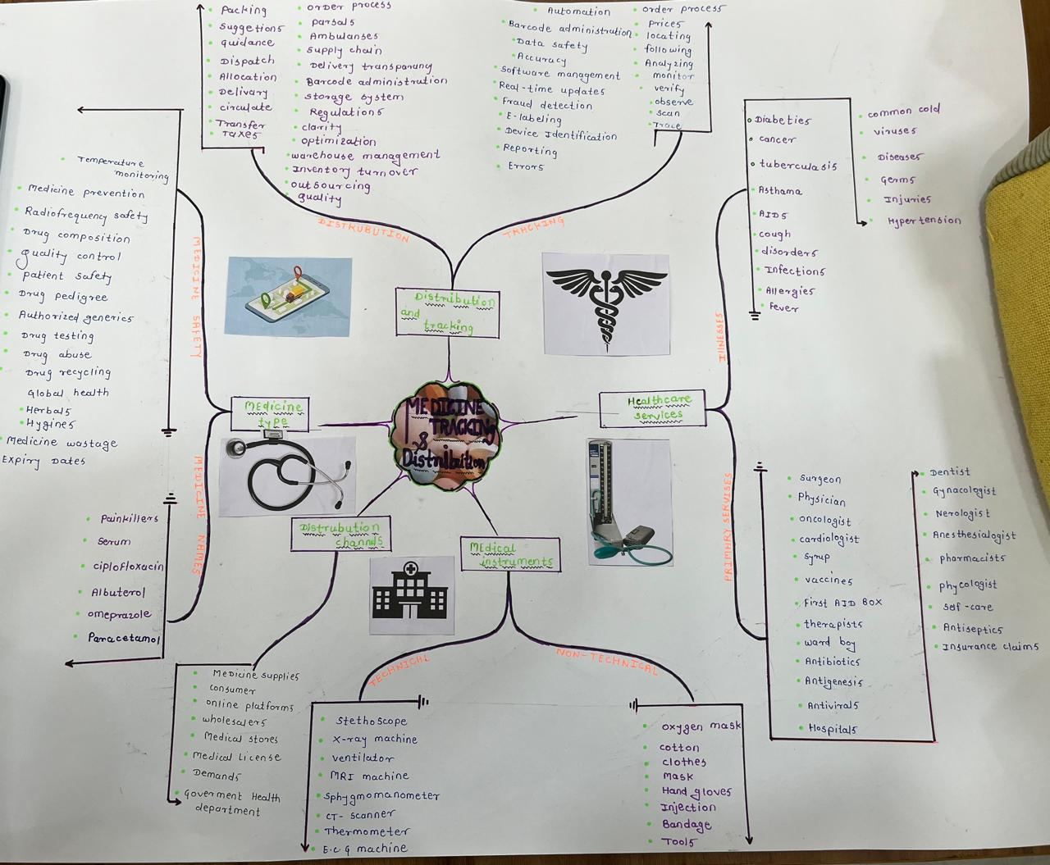
MIND MAP

Slide 6
Persona construction
Constructing a persona involves creating a detailed, fictional representation of a target audience, typically used in marketing, product design, or product development. A persona embodies the background, motivation, challenges faced, doubts and fears and aspirations of a specific group of people, helping you design better solutions.
Why persona is important ?
Personas are used to targeting market audience mins end users, focuses on their day to day life problems and design for that

Slide 7
Persona 1: for patient
MOTIVATION
Motivated by family and relatives
positive Feedback From others
Spending more time with family members
Achieving a better quality of life
Gaining confidence
BACKGROUND
Belong to middle class family
He lives in a join family in Pune
He has a two children's
He is a school teacher working in government school
He is diagnosed with diabetes
DOUBTS AND FEARS
Doubts about will their treatment effective or not
Doubts about will their illness be cured or not
Whether they can pay for hospital charges or not
Fear of being a burden on family
Will their healthcare providers are experienced or not
Fear about not achieving health goals
CHALLENGES FACED
Financial stress due to ongoing condition
Balancing work and health needs.
Disrupted Schedule
limited Understanding of disease
Adapting to lifecycle changes
follows the prescribed diet, especially with Family meals and social gathering
Forgets to take medicines on time.
ASPIRATIONS
Mentally and physically stable life
Want to make personal fulfillment
continues personal growth and learning
reduce the dependency on medicines
Summary
Amit belongs to middle class family he is diagnosed with diabetes working in a government school as a physics teacher . he facing challenges like financial , how to balance professional and personal life but he always motivated but he always motivated by positive feedback of family members .But sometimes doubts about will their illness be cured or not .Amit want reduce the dependency on medicines and wants healthy life

Slide 8
Persona 2: for healthcare provider
Motivation
Their ethics and goals
Their passion in their career
To attain High status in society
Background
He belongs to join family and live in Hyderabad
He has two daughters
He is well educated in medical site
He has high clinical experience in government hospital
He has great experience in balancing personal and professional life
DOUBTS AND FEARS
fear of incomplete knowledge, education as well as skills
Doubts on their own decision in critical conditions
fear of patient does not follow treatment
will their treatment effective or not
Challenges faced
Managing large number of patients
Handling high pressure situations mins emergency conditions
Lack of technological things
Team coordination
Surviving in the race with others
Workload, overwork stress
Shortage of workers
Aspirations
Respect from society
Professional growth and experience
Stable future as well as carrier
Improving public health
Summary
Rahul live in join family in Hyderabad .he is well educated .he was two daughters .he has a high clinical experience but sometimes he faces challenges like how to handle or to stay stable in critical conitions also sometimes he have doubt that their treatment will effective or not also he give high quality treatment to patient ..he wants stable future….

Slide 9
5W and 1H

Slide 10
QUESTIONS | DISTRIBUTION AND TRACKING | MEDICINE TYPE | HEALTHCARE SERVICES
WHEN | When should we replace or restock expired medicines. Ans : every month ending | When should I take this medicine, before or after meal Ans : according to prescription | When should a patient seek emergency healthcare services Ans : in serious conditions
WHERE | Where are the medicines are stored before distribution Ans : Isolated rooms | Where can I find information about the different types of medicine available Ans : on medicine ATM app | Where can patients find information about available healthcare services in their area Ans : on medicine ATM app
WHOM | Whom should we assign for tracking and deliveries Ans : delivery boy | Whom should I consult before starting a new type of medicine Ans : healthcare provider | Whom should patients contact to schedule a healthcare service appointment Ans : To receptionist
WHAT | What tools can help in tracking medicine Ans : mostly Google maps | What types of medicines are available in market | What types of healthcare services are available Ans : for prevention,treatment,equity
WHY | Why is important to track the medicine Ans : To deliver medicines on time | Why was this type of medicine prescribed for my condition | Why are healthcare services essential for public health
HOW | How we can identify the expire medicine Ans : by stock details | How does this type of medicine work in the body | How do healthcare services differ between urban and rural areas Ans : according to resources

Slide 11
Theory of prioritization

Slide 12
 | 1000 g | 100 g | 10 g | Total
Network issues | 4000 | 0 | 10 | 4010
Transaction problems | 5000 | 0 | 0 | 5000
Transportation updates | 3000 | 100 | 10 | 3110
Temperature monitoring | 1000 | 300 | 10 | 1310
Lack of storage | 5000 | 0 | 0 | 5000
Medicine shortage | 2000 | 300 | 0 | 2300
Misguidance | 1000 | 0 | 40 | 1040
History management | 1000 | 400 | 0 | 1400
Failure in transportation | 2000 | 100 | 20 | 2120
Quality maintaining | 0 | 0 | 50 | 50
Stock exchange | 5000 | 0 | 0 | 5000
Inventory management | 2000 | 300 | 0 | 2300
Lack of accuracy | 0 | 500 | 0 | 500
Lack of knowledge | 3000 | 0 | 20 | 3020

Slide 13
Prioritization Graph
Scale
On Y-axis
For 1000 g
1cm = 1000 g
For 100 g
1cm = 100 g
For 10 g
1cm = 10 g

Slide 14
Theory of prioritization

Slide 15
SCAMPER
S = substitute
C = combine
A = adapt
M = modify
P = put to another use
E = eliminate
R = reverse
The SCAMPER technique in design thinking is used to stimulate creativity and generate ideas by prompting questions about Substituting, Combining, Adapting, Modifying, Putting to another use, Eliminating, and Reversing elements of a design

Slide 16
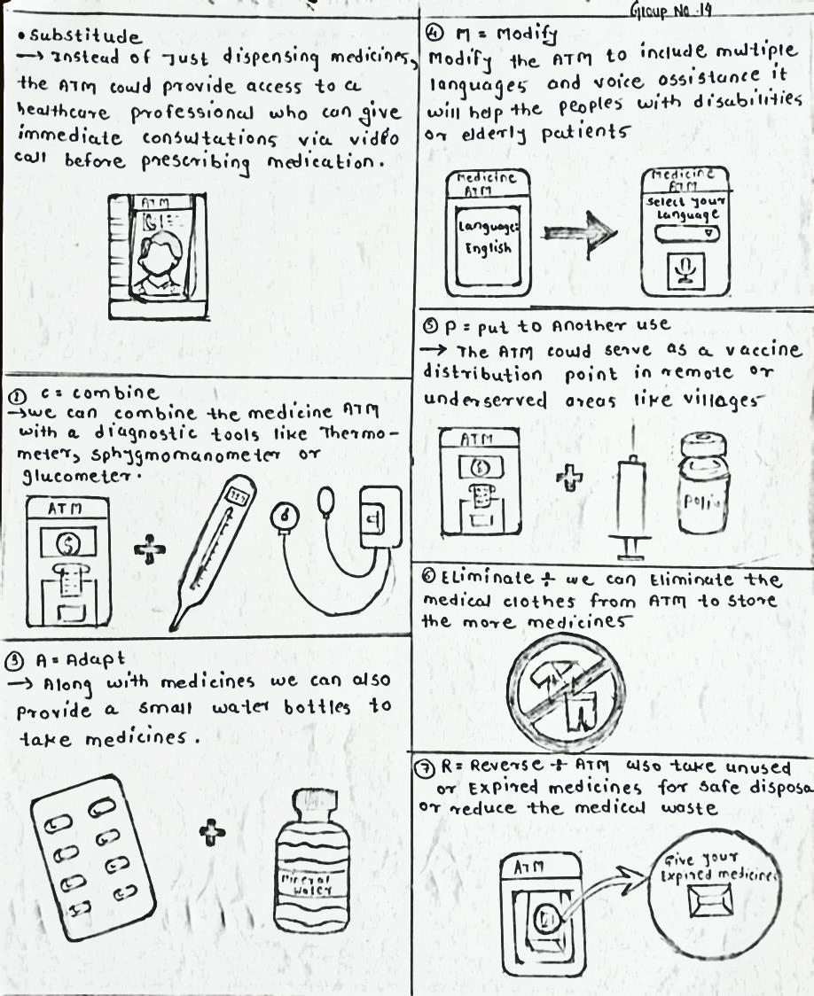
SCAMPER
Selected technique From SCAMPER
COMBINE
By combining the medicine ATM with diagnostic tools like thermometer sphygmomanometer It will helps the users To check primary illnesses
ADAPT
Along with medicine we can also provide a small water bottles to take medicines it will helps in emergency conditions also to Attract a end users towards ATM
Put to other use
The ATM could serve as a vaccine distribution point in remote or underserved areas like villages

Slide 17
Journey Map

Slide 18
Journey Map
End users
Matured person Amit
Old man
Amit approaches the medicine ATM for the first time.
Call his friend and get positive review about ATM
Try to get medicines from the ATM
Saw the advertisement poster about medicine ATM instruction app
Check the app first time and get all instructions about how to use ATM
Fear about is their medicine available or not in the stock
Check the stock in the APP
Want to check oxygen level
Find oximeter their
Check for the cash payment
Successfully did there payment
Finally return to their home
Events :- for the matured person amit

Slide 19
Journey Map
Confidence level

Slide 20
Journey map
He felt dizzy because of overtime travelling through metro
Saw the Medicine ATM on Metro station
Asking to peoples how to use ATM
Finally one boy told them about app
Find sphygmomanometer over their
Don’t know How to use sphygmomanometer
Saw in the app
After some time results will come
Their reports are positive
ATM suggest some medicines
Get medicines from ATM
After some time he feels good
Events :- For old Man

Slide 21
Journey map
Confidence level

Slide 22
Thank you !

